Slide 1
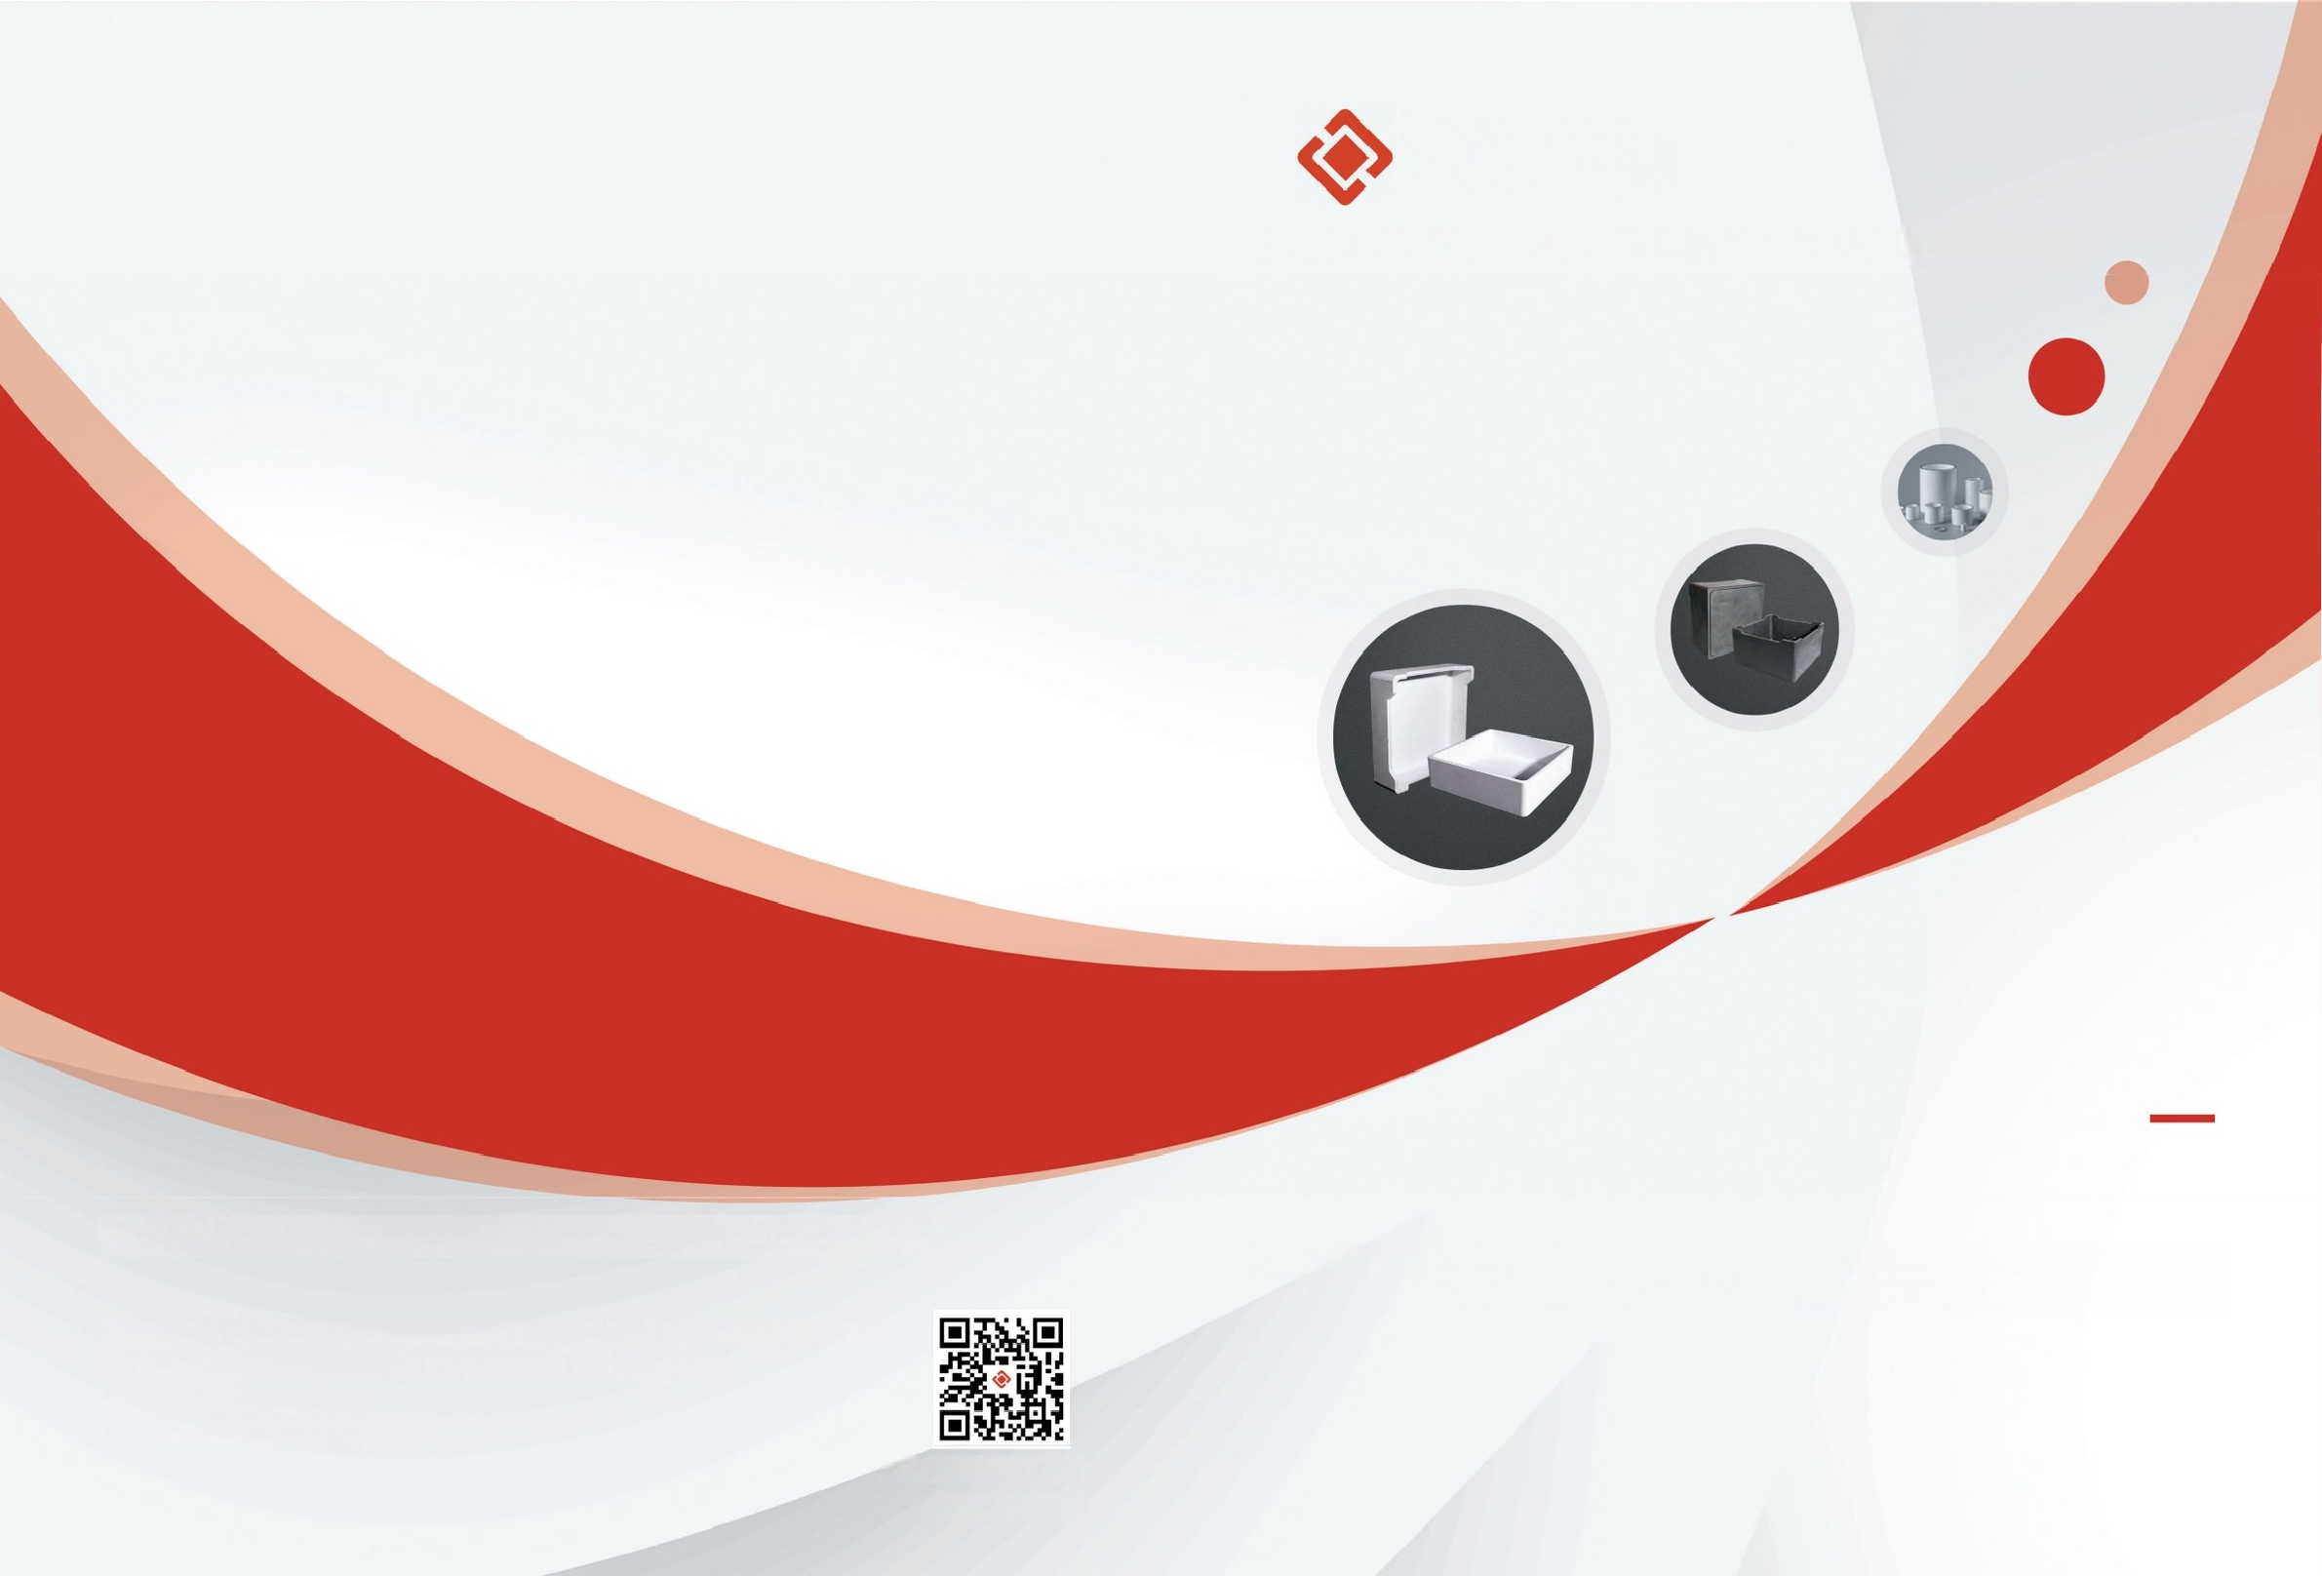
中瓷
ZCXC
Changsha zhongci new material technology Co.,LTD
Changsha zhongci new material technology Co.,LTD
Address:No.98,Xintian North Road,Ningxiang High-tech Industrial Park,Hunan Province
Email:sales@zcxc.cc
Official Website:www.zcxc.cc
WhatSapp:8616680447294
Mullite Saggar :for lithium battery cathode material sintering
Graphite saggar:built for lithium iron phosphate (LFP) and anode materials,
Scan the QR-code to visit the official website

Slide 2


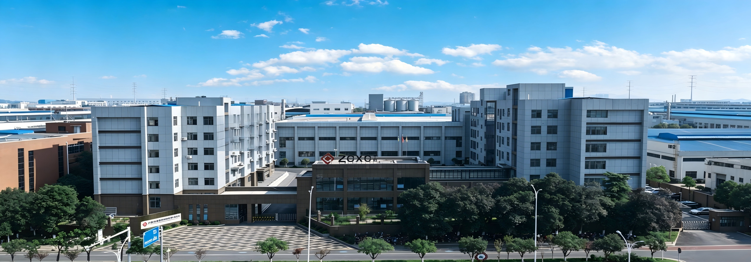
IINTEGRITY,KINDNESS,SELF-IMPROVEMENT,INNOVATION
ZCXC 盎
COMPANY PROFILE
Changsha Zhongci New Material Technology Co., Ltd. is a professional manufacturer specializing in high-performance ceramic and graphite products. Our core business spans thermal field consumables for lithium batteries, supporting materials for PV energy storage, industrial electronic ceramics, and precision grinding media. We are dedicated to enabling high-temperature sintering, graphitization, powder processing, and power transmission applications across the new energy, electronics and advanced manufacturing sectors. We dedicate ourselves to supporting the high-temperature sintering and graphitization processes of lithium batterycathode and anode materials, delivering high-reliability kiln furniture solutions for the global new energy battery industry.
Our core product portfolio includes two main series of saggers for battery material production:
Corundum-mullite and cordierite-mullite saggers (mullite cordierite saggers), with an annual production capacity of 4 million units
Graphite saggers, with an annual production capacity of 600,000 units
We develop application-specific saggers tailored for a wide range of battery material systems, including ternary cathode materials (NCM/NCA), sodium-ion battery materials, lithium cobalt oxide (LCO), lithium manganate (LMO) and lithium iron phosphate (LFP). These products serve as critical consumable kiln furniture throughout the cathode material sintering and anode material graphitization processes.
Leveraging our proprietary core compression molding technology, our graphite saggers feature outstanding flexural and compressive strength. Compared with traditional assembled or solid-machined graphite saggers, our solutions deliver superior performance in production output, cost efficiency, manufacturing yield and quality consistency, earning wide recognition across the lithium battery industry.
Key Client Partnerships
We maintain close strategic partnerships with leading enterprises across the lithium battery industrial chain, covering top-tier cathode material manufacturers and power battery giants. 70% of our sales revenue comes from industry leaders.
Our core partners include CTAL, BYD, BASF Shanshan, Wanhua Chemical and Huayou Cobalt. In 2023, we were honored with the "Best Quality Supplier" award by Huayou Cobalt, a testament to our stable product quality and reliable supply capability.
with our partners.
Our production bases cover a total area of 68,000 square meters, with a workforce of over 300 employees. The company has maintained annual revenue exceeding RMB 250 million for three consecutive years.
03 >>>

Slide 3
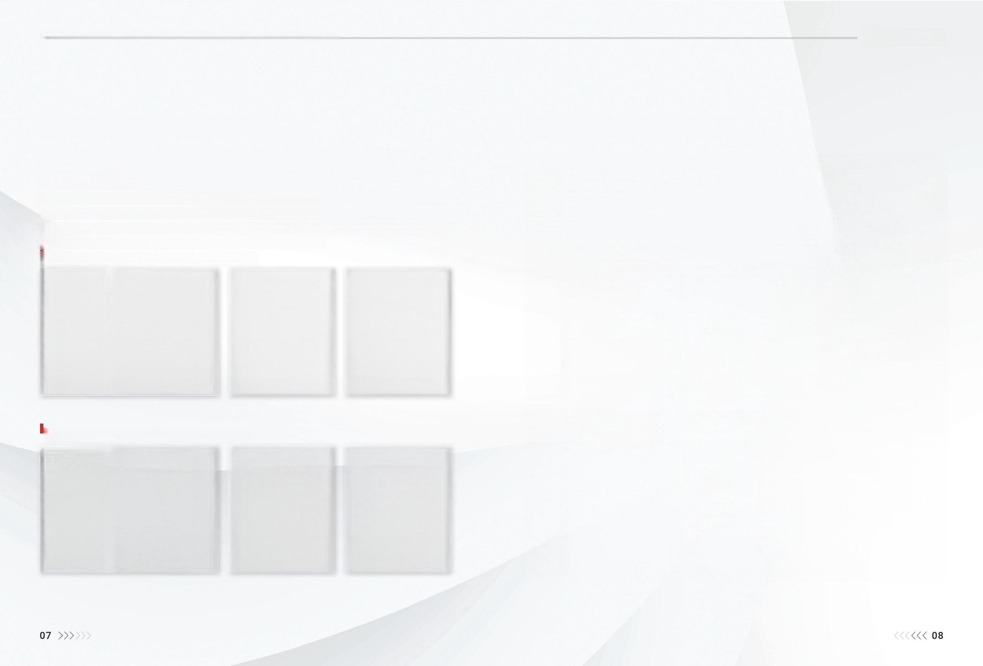

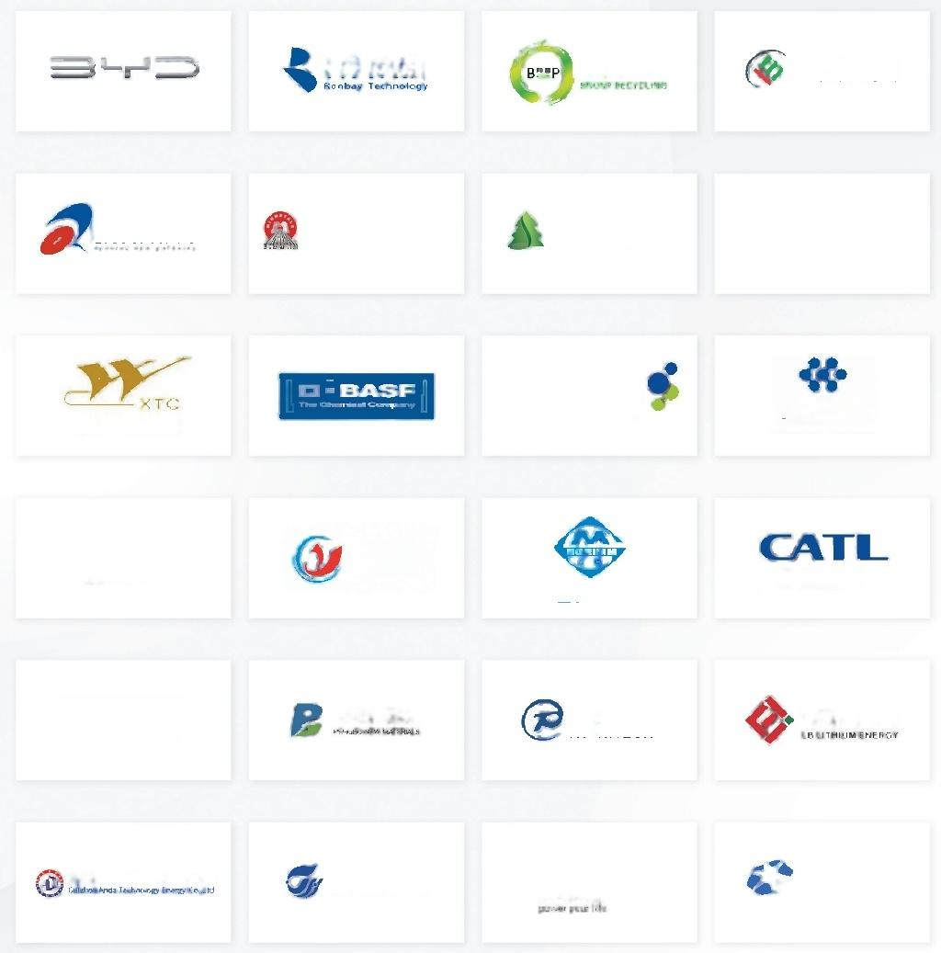
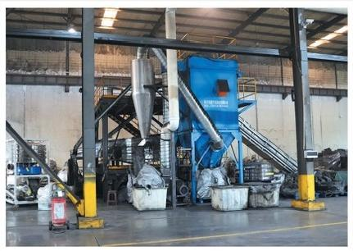
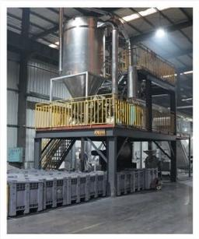
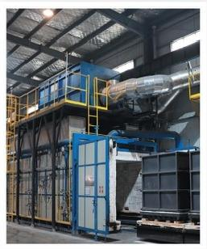
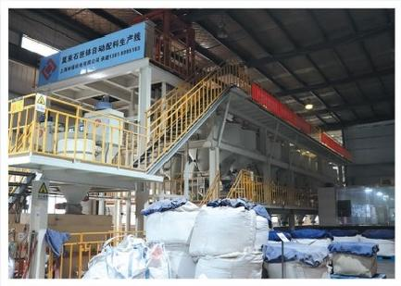
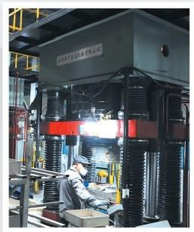
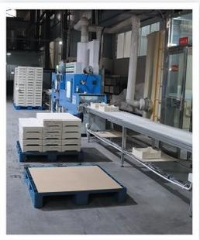
IINTEGRITY,KINDNESS,SELF-IMPROVEMENT,INNOVATION
ZCXC 盎
MANUFACTURING SCENE
After years of technological research and development and market cultivation,it has currently become a leading enterprise in the industry and has gradually formed a full-coverage product series including mullite crucible,
corundum crucible,lithium iron phosphate crucible,graphitization crucibles,etc.
The graphite crucible produced adopt the internationally leading single-die compression molding technology. They are smooth and flat,with no obvious surface defects and no obvious granular feeling.The products have high purity,excellent mechanical properties,strong temperature and corrosion resistance,outstanding oxidation resistance,long service life and high comprehensive cost-performance ratio.
PARTNER CUSTOMER
瑞翔新材 厦门钨业 G∈I VI 格林美 德方纳米 Dynanonic 贵州安达科技能源股份有限公司 | 容百科技 湖南长远锂科有限公司 HUNAN CHANGYUANLICO cO,LTD, 裕 能 鹏博新材 WANHUA | 邦普循环 FIRS杉杉 sinowatt 振 华 新 能 源 当升科技 融通高科 RT-HITECH BTR | 巴莫科技 LIBG DE 宜宾锂宝 华友钴业 HUAYOU COBALT 宁德时代 龙佰锂能 SHINZO》m
Graphite Product Production Equipment Display
Mullite Product Production Equipment Display

Slide 4
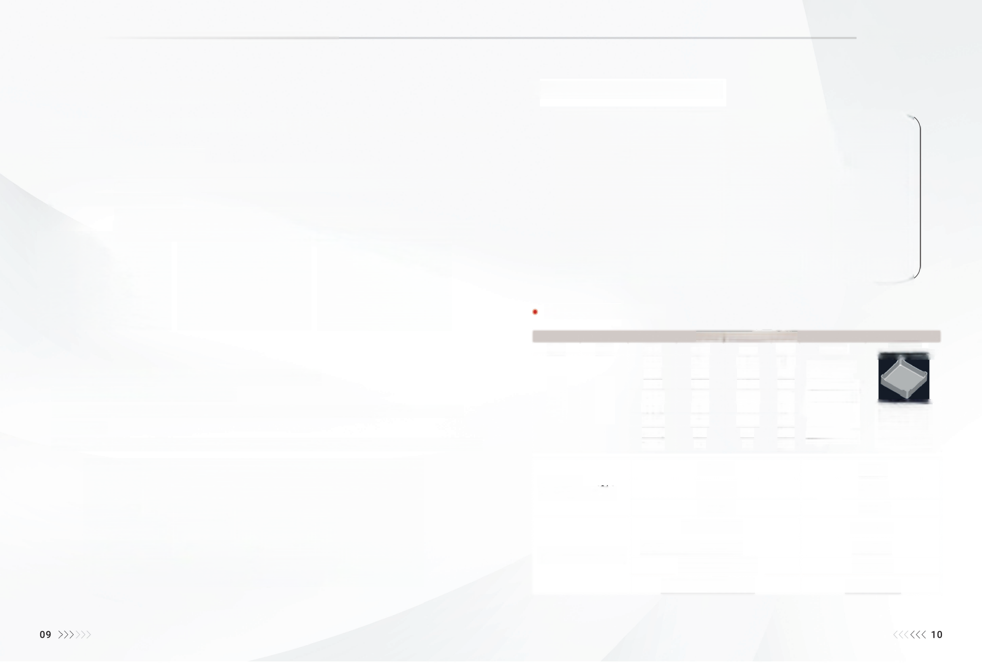

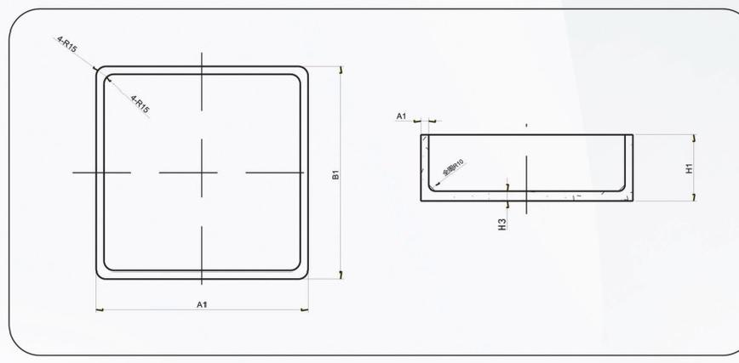
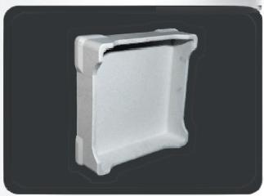
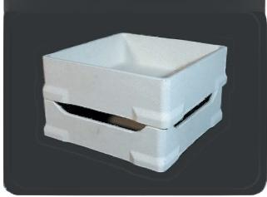
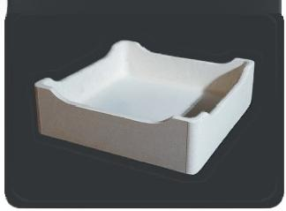

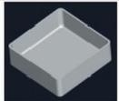
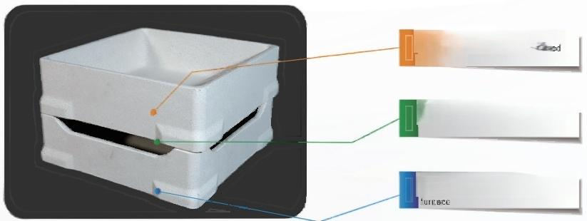
IINTEGRITY,KINDNESS,SELF-IMPROVEMENT,INNOVATION
ZCXC 盎
▶ MULLITE Sagger
● Mullite Sagger NCA/NCM/LOM Series
● Application fields:Cathode ternary materials,NCA/NCM/LCO/LMO,electronic ceramics,rare-earth materials,magnetic materials
● Applicable temperature:900℃-1500℃
● Product features:1.It has excellent corrosion-resistance,is not easy to powder or peel off,and has a long service life.
2.It has excellent thermal-vibration resistance and flexural strength,does not deform or crack in the kiln,and has a high turnover times.
3.High product consistency and stable operation on automated equipment.
4.Smooth appearance without impurities,dust,and extremely low magnetic substance content.
Specifications for sagger
Specification Parameters
A1 | B1 | H1 | H2 | A2 | A4 | Other | Graphic.
320 330 340 350 | 320 330 340 350 | 75 | 15 | 240 | 12 | The depth of the cylinder and the middle height can be customized according to customers' requirements. | Bepresentation
 |  | 80 | 15 | 240 | 12
 |  | 85 | 15 | 270 | 12
 |  | 100 | 15 | 270 | 12
 |  | 120 | 20 | 260 | 12
 |  | 130 | 20 | 260 | 12
 |  | 150 | 0 | 0 | 12
 |  | 120 | 0 | 0 | 12
● Main specifications and product models of Sagger
The main shapes and dimensions are as follows:
Mullite crucible:Various sizes such as 320x320mm-340x340mm(Can be customized according to customers' requirements)
dlanionehen stngutan equipment
When used on the roller-hearth kiln,it can meet the gas-emission requirements
Theflatness at the bottom is excellent, and it is not easy to deviate on the RHK
Chemical Composition(%) | SiO₂ (%) | 18-27
 | Al₂O₃ (%) | 55-65
 | MgO(%) | 5.5-12
Physical Properties | Porosity(%) | 21.5-26.5
 | Water Absorption(%) | 8.5-13.5
 | Flexural Strength | 9-10Mpa
 | Bulk Density(g/cm³) | 2.1-2.4/cm³

Slide 5

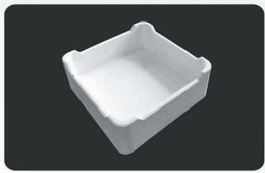
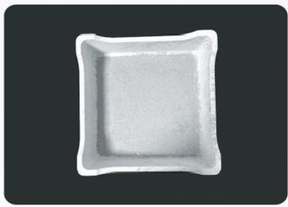
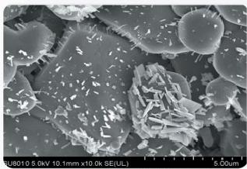
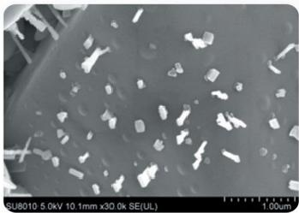
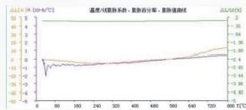
IINTEGRITY,KINDNESS,SELF-IMPROVEMENT,INNOVATION
▶ LITHIUM NON-PERMEABLE CRUCIBLE ▶ THE SALT MELT DOES NOT WET THE SAGGARS
● Field of Application:
Lithium cobalt oxide,lithium iron phosphate,lithium-containing electrolytes,etc.
● Adaptation Temperature:
600—1450℃
● Product Features:
It does not wet the liquid-phase of the lithium-containing melt,is easy to sinter,and can effectively prevent the penetration of the lithium-containing melt
Adjustable to zero expansion and a strength far higher than that of conventional crucible.High-cost-performance products can be adjustable according to users'needs
It runs stably on automated equipment
The content of magnetic substances is extremely low Smooth appearance without impurities or dust
● Product Parameter Table:
● Field of Application:
Cathode ternary materials,NCA,NCM,LCOLMO,electrolytes,rare-earth materials,magnetic materials,metal smelting,melting blocks,
high-temperature oxidation resistance protection,etc.
· Adaptation Temperature:
600—1650℃
● Product Features:
It has excellent corrosion resistance and does not wet inorganic and
metal melts represented by positive electrode materials,electrolytes,
and glass
It can be adjusted in combination with user-needs to adapt to different
application scenes
^{Adjustable} ^{to} ^{zero} ^{expansion} ^{and} ª ^{strength} ^{far} ^{higher} ^{than} ^{that} It is non-wettable to the melt
of conventional crucible.High-cost-performance products can be ^{represented} ^{by} ^{the} ^{cathode} ^{materials}
adjustable according to users'needs.
It runs stably on automated equipment.
The content of magnetic substances is extremely low
Smooth appearance without impurities or dust
The coefficient of thermal
It does not wet the lithium-containing melt
Chemical Composition(%) | SnO₂%) | 8-10
 | ZrO₂ (%) | 25-30
 | Y₂O₃ (%) | 4-7
 | Al₂O₃ (%) | 40-50
 | Mgo(%) | 15-20
Physical Properties | Porosity(%) | 2-3%
 | Flexural Strength(MPa) | 15-18
 | Bulk Density(g/cm³) | 2.8-3.0
● Product Parameter Table: expansion can be regulated
(zero-expansion can be achieved)
Chemical Composition(%) | ZrO₂%) | 26-30
 | Y₂O₃ (%) | 5-8
 | Al₂O₃ (%) | 40-50
 | MgO(%) | 15-20
Physical Properties | Porosity(%) | 4-5%
 | Flexural Strength(MPa) | 12-15
 | Bulk Density(g/cm³) | 3.0-3.1
11 >>>
<<<12

Slide 6


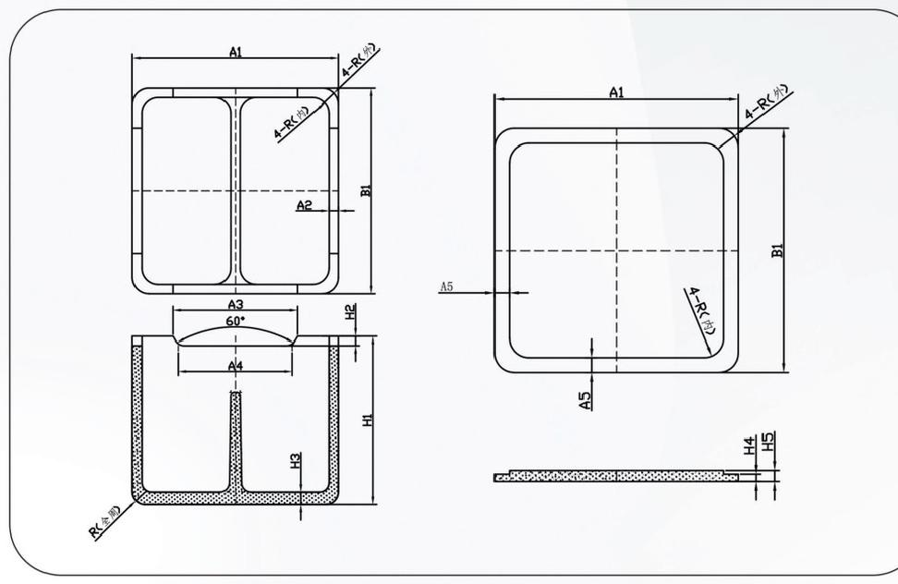
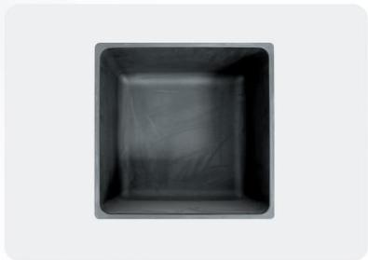
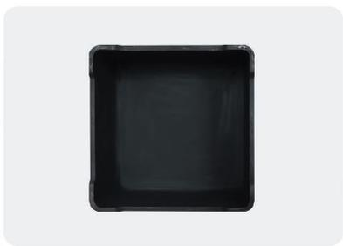
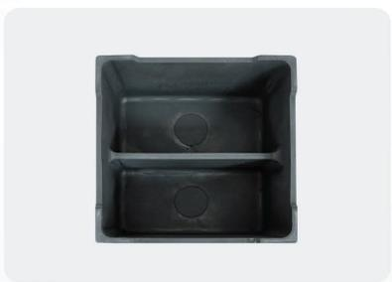
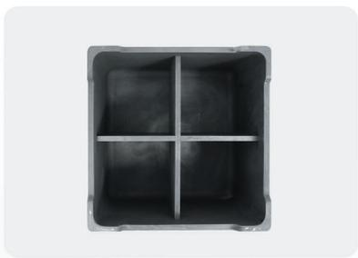
IINTEGRITY,KINDNESS,SELF-IMPROVEMENT,INNOVATION
ZCXC 盎
▶ GRAPHITE CRUCIBLE
● Field of Application:
Positive-electrode lithium iron phosphate materials and other oxygen-free sintering fields of negative-electrode materials
● Adaptation Temperature:
1000℃—3000℃
● Product Features:
1.Strong stability:high-purity,high-density,high mechanical strength and strong chemical stability.
2.Long-service life,oxidation-resistant,corrosion-resistant,with a service life of more than 24 months.
3.Excellent resistance to thermal vibration,electrical conductivity and thermal conductivity
· Graphite Crucible Series
● Technical Parameters of Graphite Crucible
Index B Material | ulk Density R (g/cm³) | esistivity C (sμQ-m) | ompressive Strength (Mpa) | Flexural Strength (Mpa) | Coefficient of Thermal Expansion (x10-6/℃) | Thermal Conductivity (Kc/mh℃) | Ash Content (≤%) | Carbon Content (%)
Molded High-purity | ≥1.78 | ≤8 | ≥75 | ≥30 | 4.5 | >185 | <0.1 | 99.8
13 >>>>>>
<<<14

Slide 7

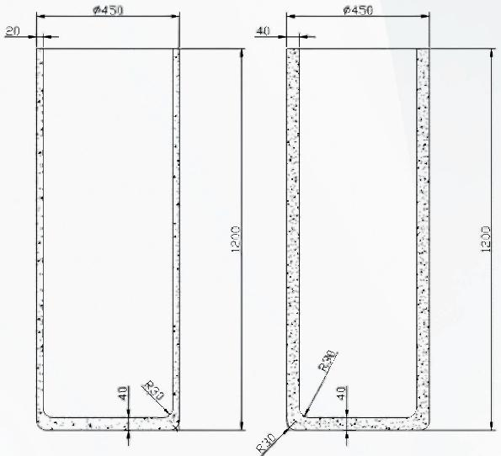
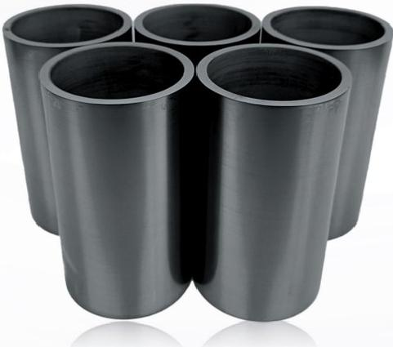
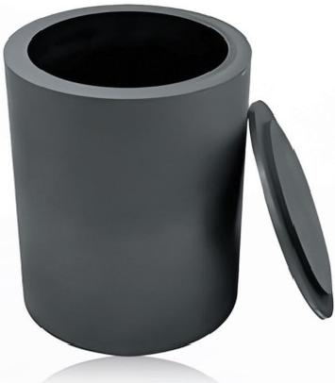
IINTEGRITY,KINDNESS,SELF-IMPROVEMENT,INNOVATION
ZCXC 盎
▶ GRAPHITIZATION CRUCIBLE
● Field of Application:
Graphitization crucibles are large-sized containers made of high-purity graphite materials and are widely used in fields such as high-temperature smelting,metal casting,crystal growth,and chemical synthesis.
● Adaptation Temperature:
3000℃
● Product Features:
High-temperature resistance:Graphite can withstandhigh temperatures above 3000℃in an inert atmosphere. In an oxidizing environment,it requires coating protection(Usually used up to about 500-800℃)
Excellent thermal conductivity:It has ahigh thermal conductivity coefficient and can transfer heat quickly and evenly.
Chemical stability:Resistant to acid-and alkali-corrosion(Except for strongly oxidizing acids),suitable for smelting active metals(Such as lithium,aluminum,copper,etc.).
· Graphitization Crucible Series
● Technical Parameters of Graphitization Crucibles
Material | Technical Standards | Material | Technical Standards
Wall Thickness | 40mm | Number of Quality- Assurance Times | The average number of usage times>6 times
Bottom Thickness | 45mm | Flexural Strength | Mpa≥10
Lid Thickness | 40mm | Modulus of Elasticity | Gpas9.3
Rim | Length:50mm,thickness:50mm | Coefficient of Thermal Expansion | (10-6/℃)(Room-temperature to 600°℃)≤2.9
Thickness Deviation | ≤±1mm | Overall | Smooth and even;smooth and flat
Specific Resistance (Resistivity) | ≤30μQ m | Surface | There are no cracks on the inner and outer surfaces of the billet.
Verticality Deviation | ≤±1° | Interlayer | No interlayer
Bulk Density | >1.68g/mm³ | Specification | φ400-600mm H1000-1200mm
Ash Content | <0.2% | It can be customized according to customers'requirements
15 >>>> <<<16

