Slide 1
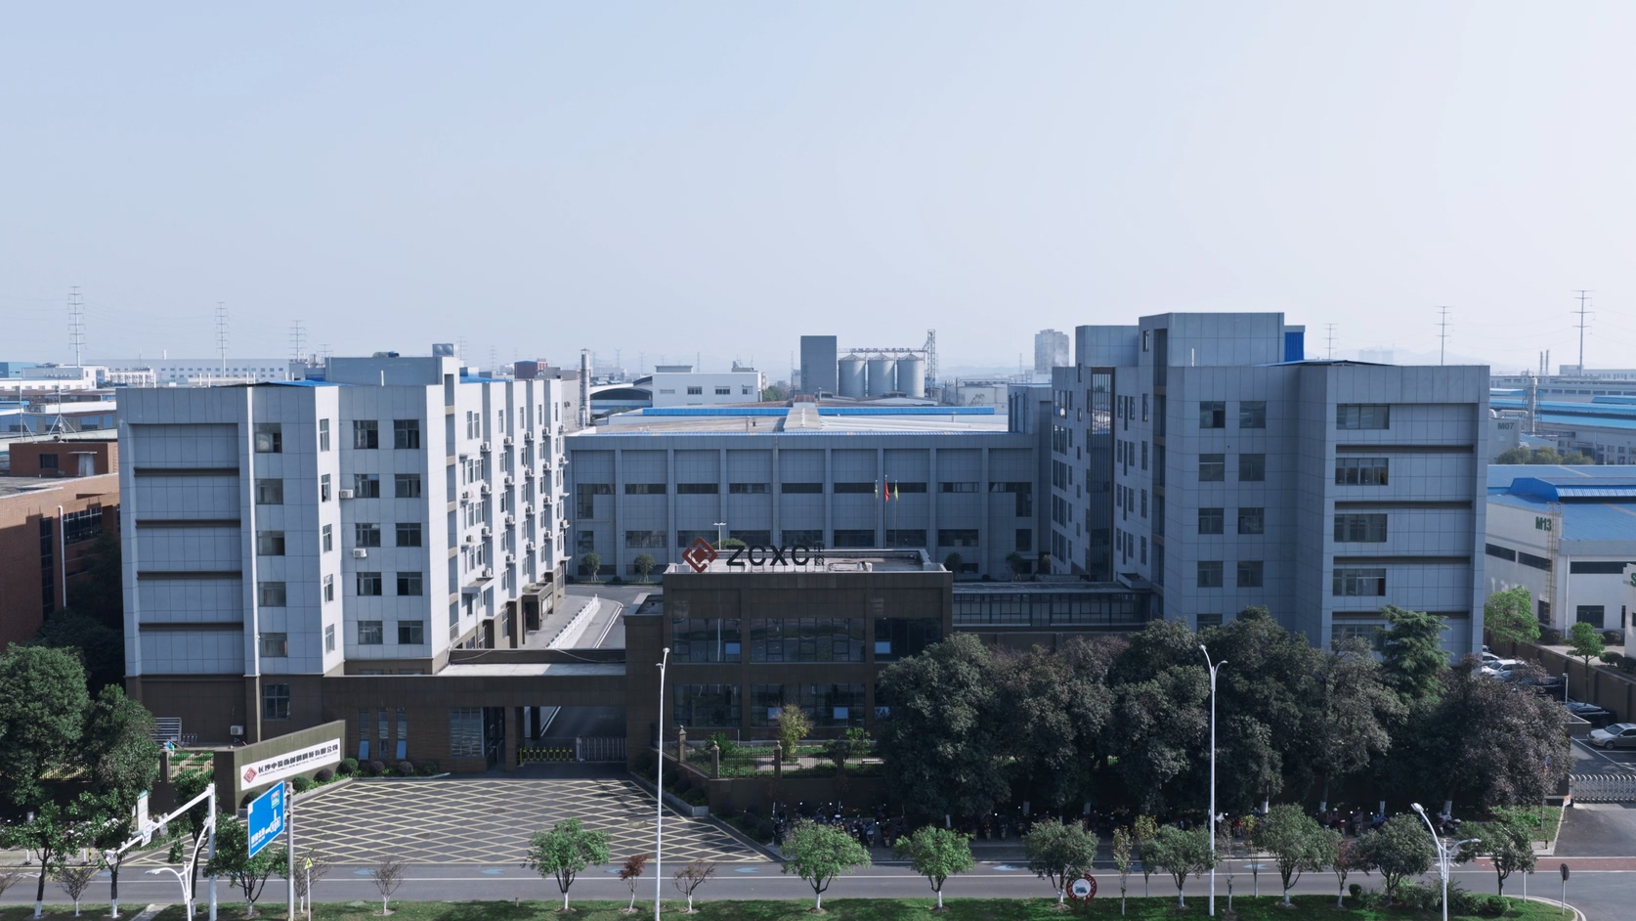

Changsha Zhongci New Material Technology Co., Ltd. is a professional manufacturer specializing in thermal field consumables for lithium battery manufacturing. Focused on supporting the high-temperature sintering and graphitization processes for cathode and anode materials, we deliver highly reliable kiln furniture solutions to the global new energy battery industry.
Our core product portfolio covers two primary categories of thermal field consumables for battery material production. The ceramic kiln furniture series includes cordierite-mullite saggers, corundum-mullite saggers and sodium-ion dedicated saggers, with a combined annual production capacity of 4 million units, designed for cathode material sintering and precursor calcination in oxidizing atmospheres. The graphite thermal consumable series comprises graphite saggers (annual capacity: 600,000 units) and large-format graphitization crucibles, purpose-built for the ultra-high-temperature graphitization process of anode materials in inert atmospheres.
Our ceramic sagger solutions are compatible with all mainstream cathode material systems, including ternary cathode materials (NCM/NCA), sodium-ion cathode materials, lithium cobalt oxide (LCO), lithium manganate (LMO) and lithium iron phosphate (LFP), supporting key processes ranging from cathode precursor calcination to final cathode sintering. Our graphite products serve as critical consumables throughout the anode graphitization workflow, delivering stable performance under ultra-high temperature conditions.
We maintain close strategic partnerships with leading enterprises spanning the full lithium battery industry chain, including top-tier cathode material manufacturers, precursor producers and power battery giants. 70% of our sales revenue comes from industry frontrunners. Our key partners include CTAL, BYD, BASF Shanshan, Wanhua Chemical and Huayou Cobalt.
Our production bases span a total area of 68,000 square meters, with a workforce of over 300 employees. The company has sustained annual revenue exceeding RMB 250 million for three consecutive years, ensuring robust, scalable supply support for partners worldwide.
Changsha Zhongci New Material Technology Co., Ltd.
No. 98, Xintian North Road, Ningxiang High-tech Industrial Park, Hunan Province China.
Emali: sales@zcxc.cc
WhatsApp: 8616680447294
Website: www.mullitesagger.com
WeChat＆TEL: 8616680447294

Slide 2
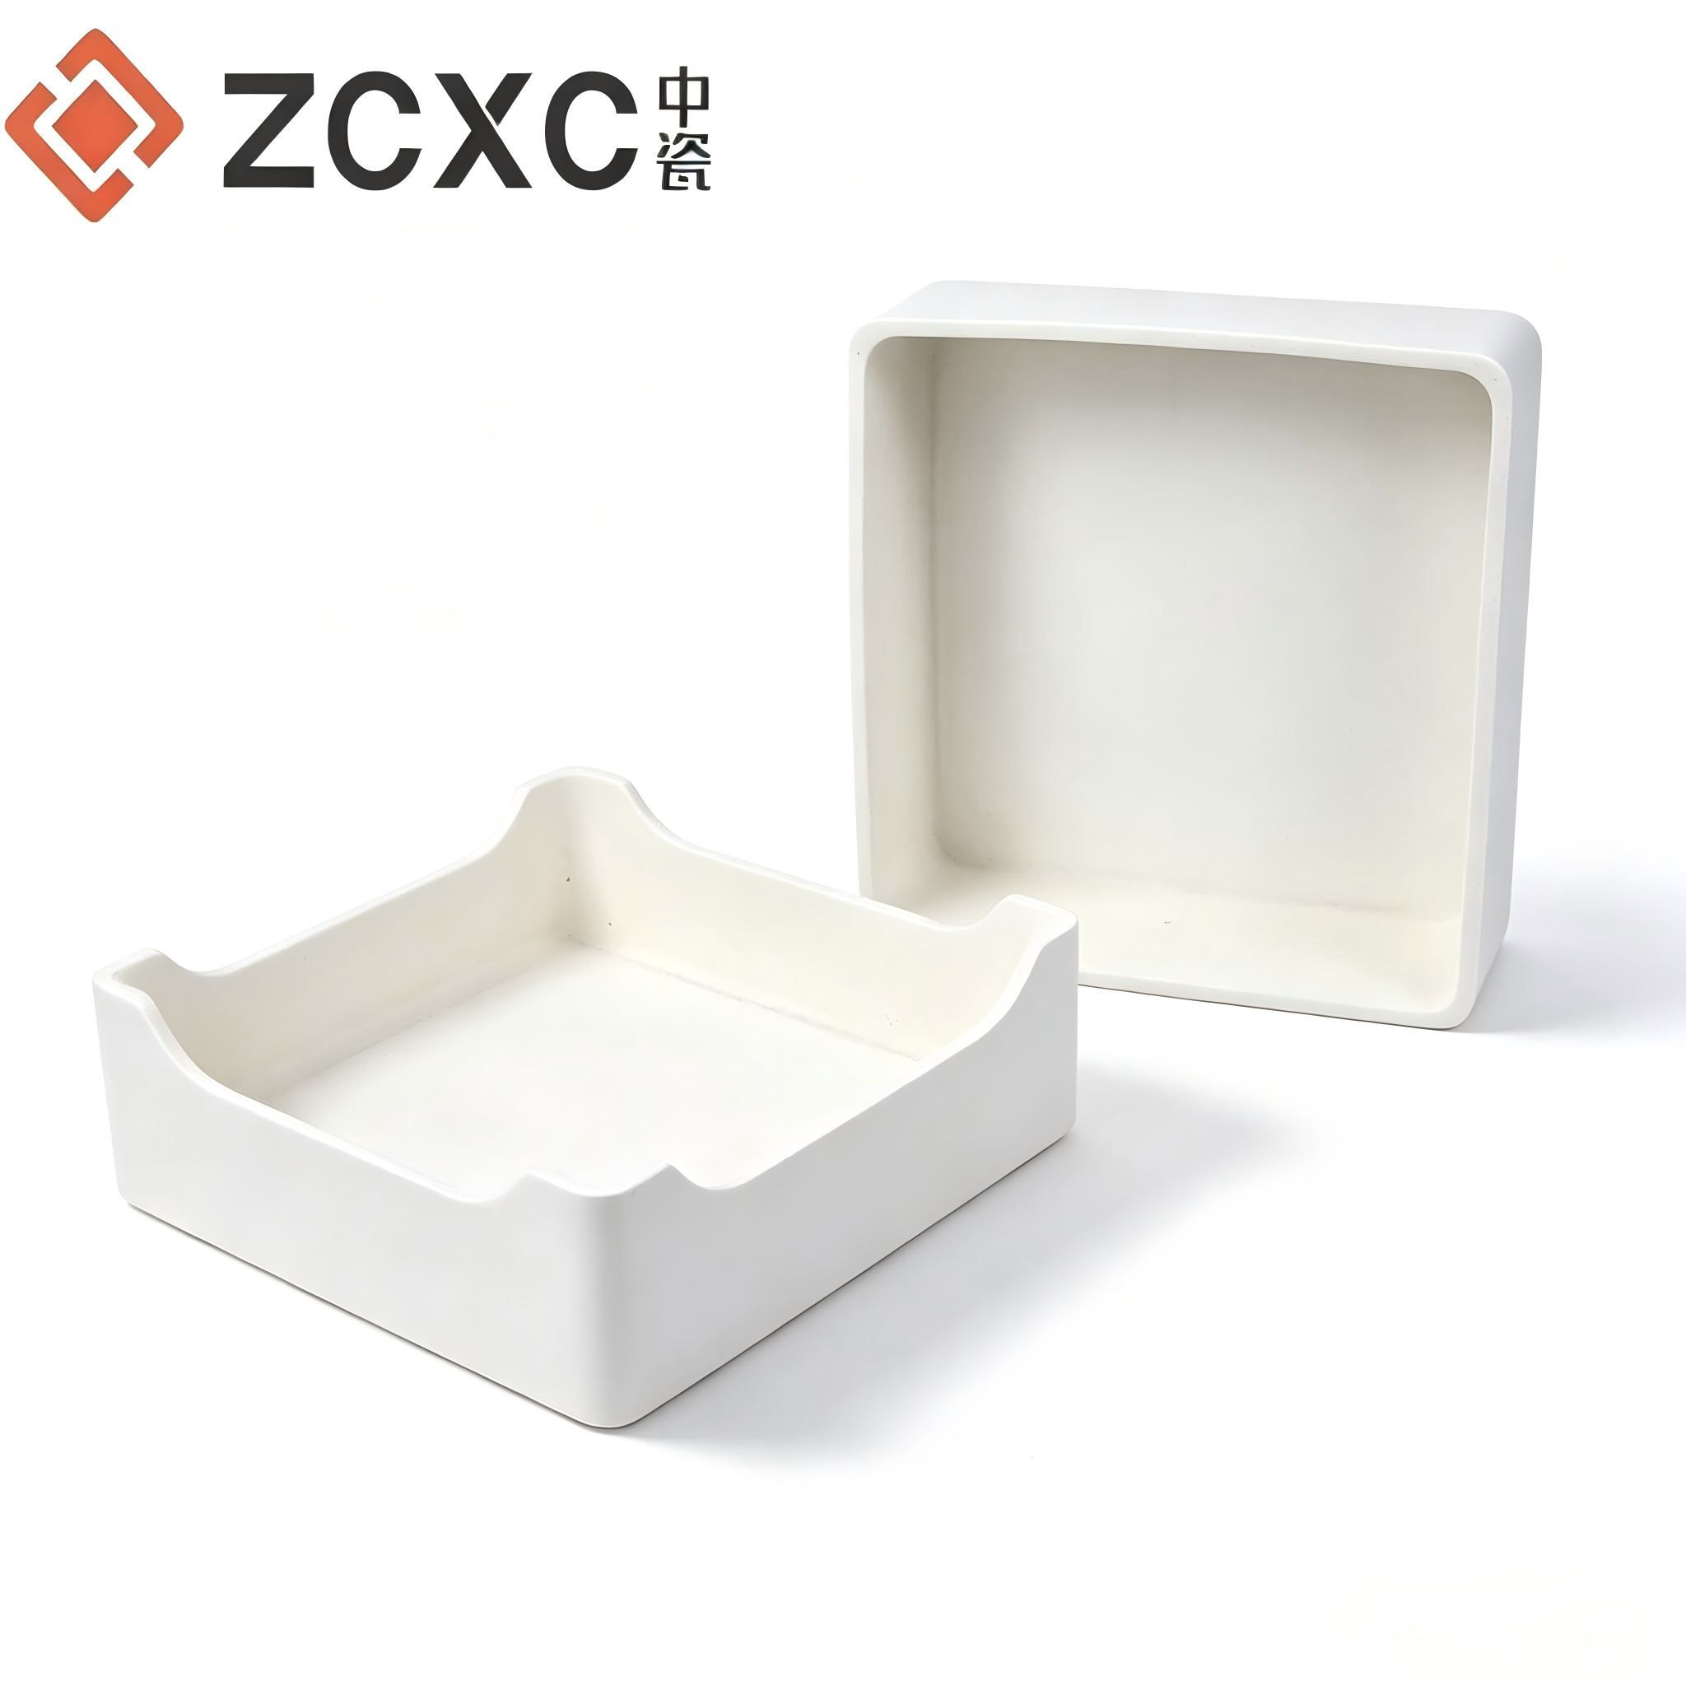
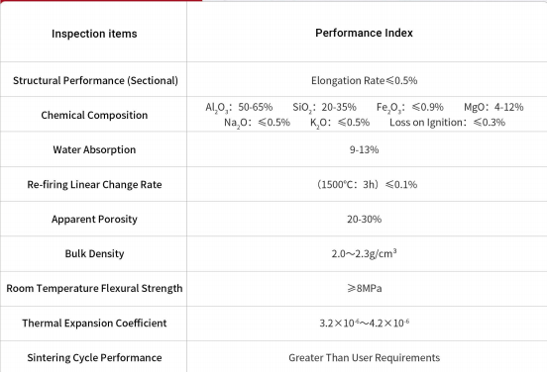
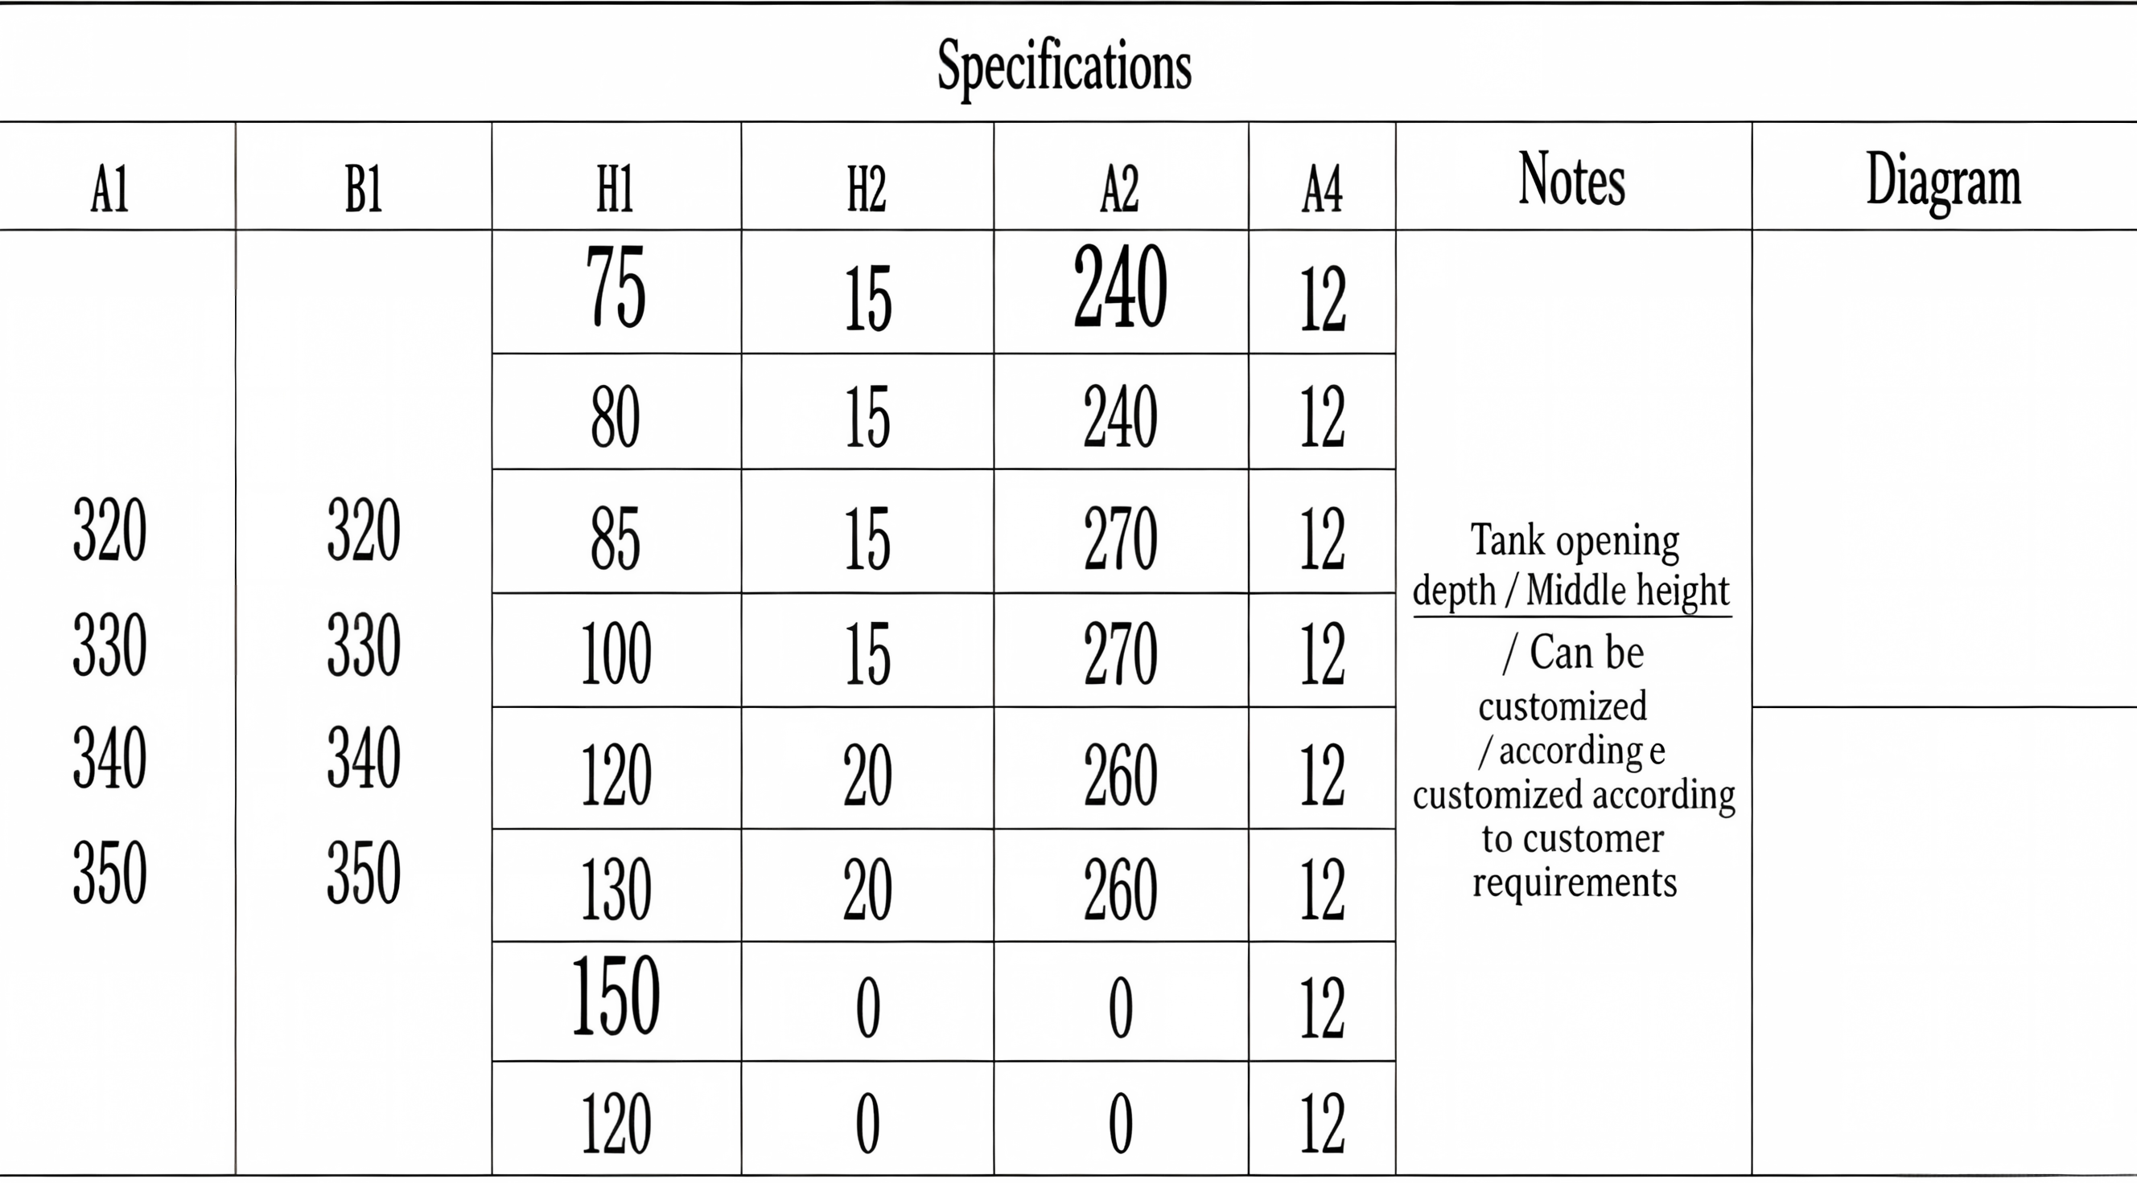
◎（Application Fields）： （Cathode ternary materials, NCA/NCM/LCO/LMO, electronic ceramics, rare earth materials, magnetic materials）
●（Operating Temperature）： 900℃-1500℃
● （Product Features）： （ 1.Excellent corrosion resistance, highly resistant to powdering and surface peeling, with long service life.）
（2.Outstanding thermal shock resistance and flexural strength,no cracking under kiln operating conditions）
（3.Smooth surface free of impurities and dust）
( 4.Extremely low magnetic impurity content)
▶ Mullite Sagger
规格参数
A1 | B1 | H1 | H2 | A2 | A4 | 其他 | 图示
320 330 340 350 | 320 330 340 350 | 75 | 15 | 240 | 12 | 缸口深度 中间高度 可根据客户 要求订制
 |  | 80 | 15 | 240 | 12
 |  | 85 | 15 | 270 | 12
 |  | 100 | 15 | 270 | 12
 |  | 120 | 20 | 260 | 12
 |  | 130 | 20 | 260 | 12
 |  | 150 | 0 | 0 | 12
 |  | 120 | 0 | 0 | 12
规格参数
A1 | B1 | H1 | H2 | A2 | A4 | 其他 | 图示
320 330 340 350 | 320 330 340 350 | 75 | 15 | 240 | 12 | 缸口深度 中间高度 可根据客户 要求订制
 |  | 80 | 15 | 240 | 12
 |  | 85 | 15 | 270 | 12
 |  | 100 | 15 | 270 | 12
 |  | 120 | 20 | 260 | 12
 |  | 130 | 20 | 260 | 12
 |  | 150 | 0 | 0 | 12
 |  | 120 | 0 | 0 | 12
规格参数
A1 | B1 | H1 | H2 | A2 | A4 | 其他 | 图示
320 330 340 350 | 320 330 340 350 | 75 | 15 | 240 | 12 | 缸口深度 中间高度 可根据客户 要求订制
 |  | 80 | 15 | 240 | 12
 |  | 85 | 15 | 270 | 12
 |  | 100 | 15 | 270 | 12
 |  | 120 | 20 | 260 | 12
 |  | 130 | 20 | 260 | 12
 |  | 150 | 0 | 0 | 12
 |  | 120 | 0 | 0 | 12

Slide 3
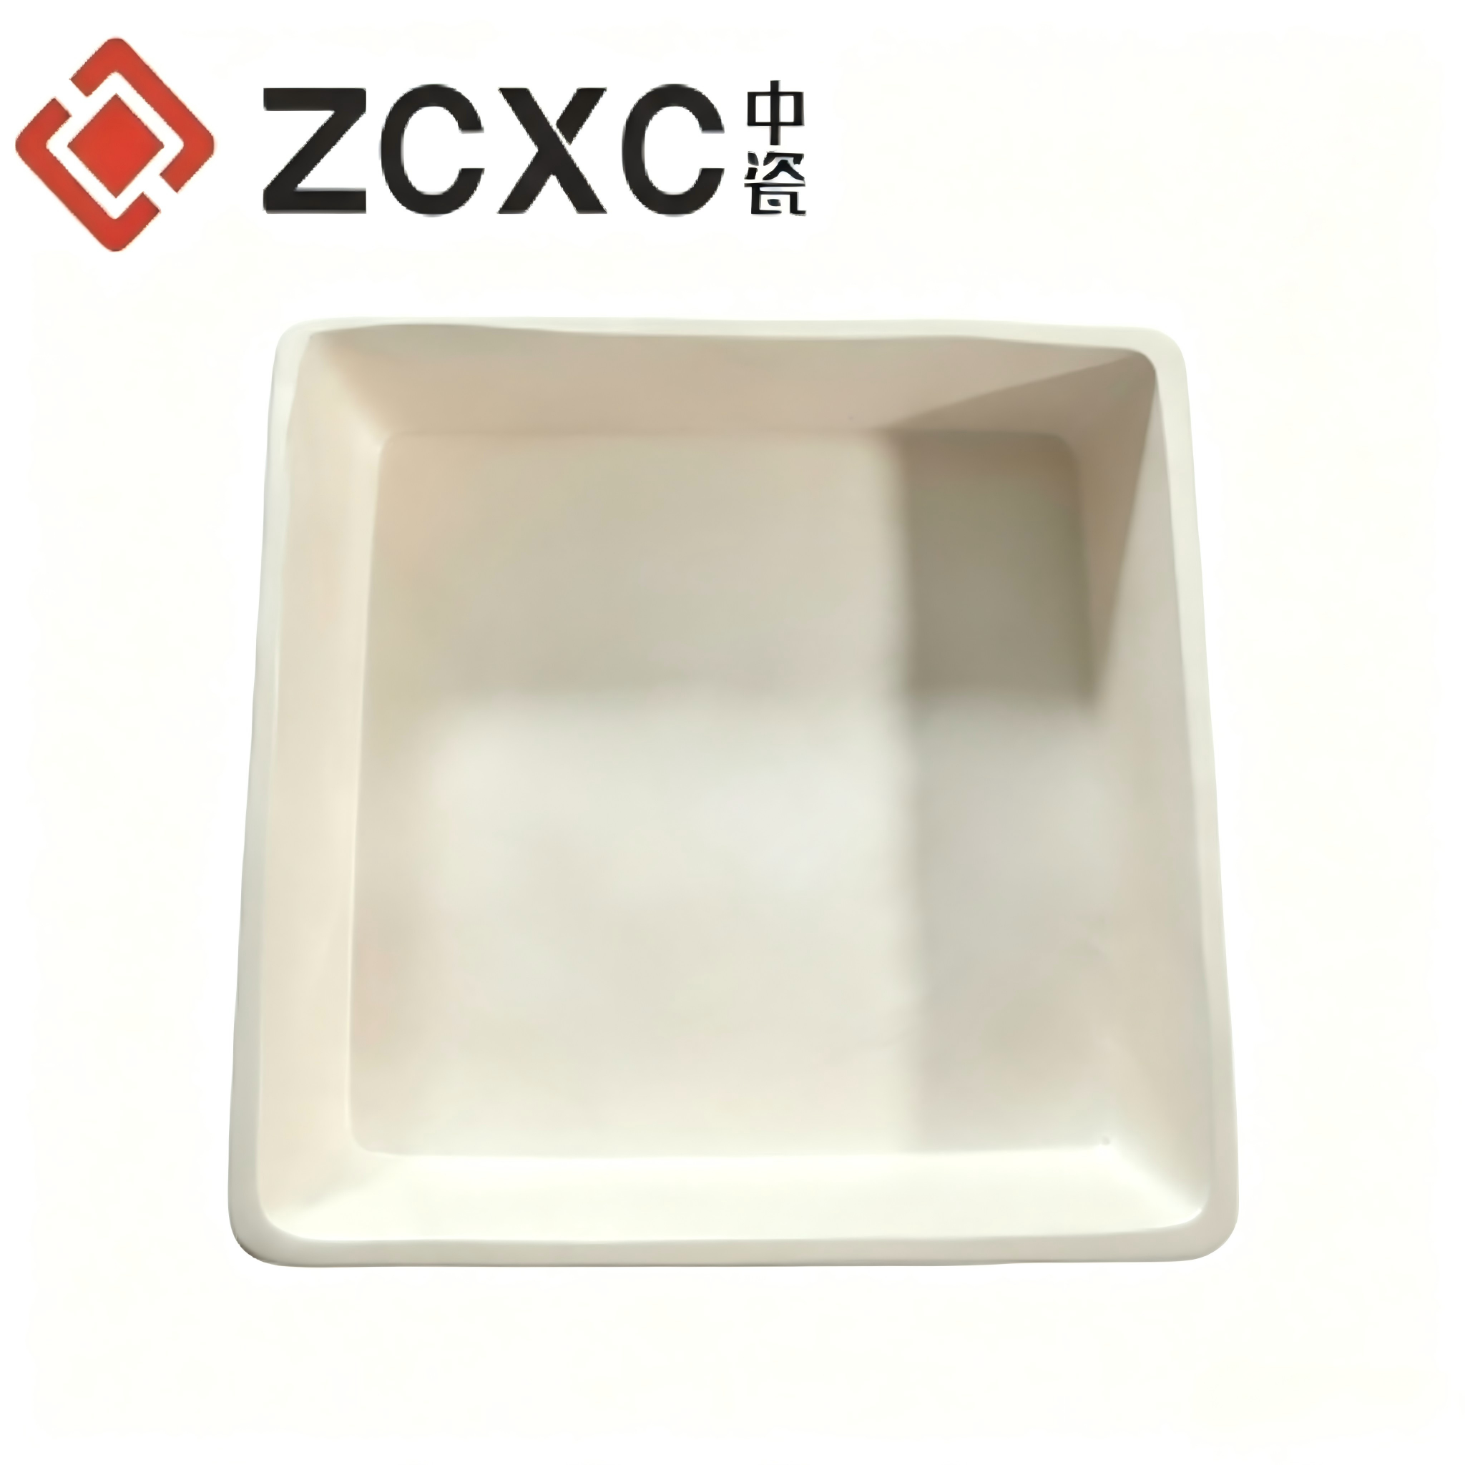
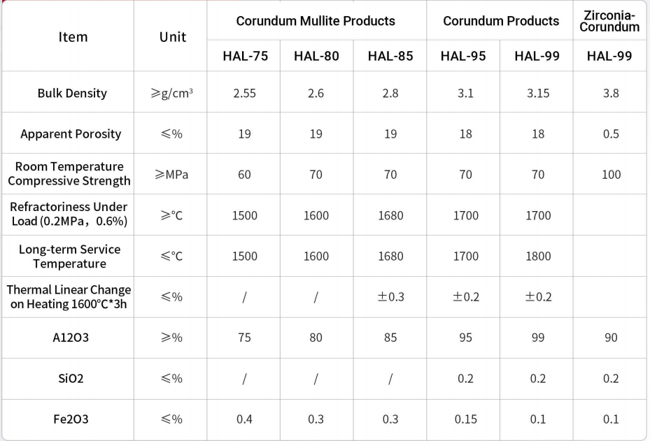
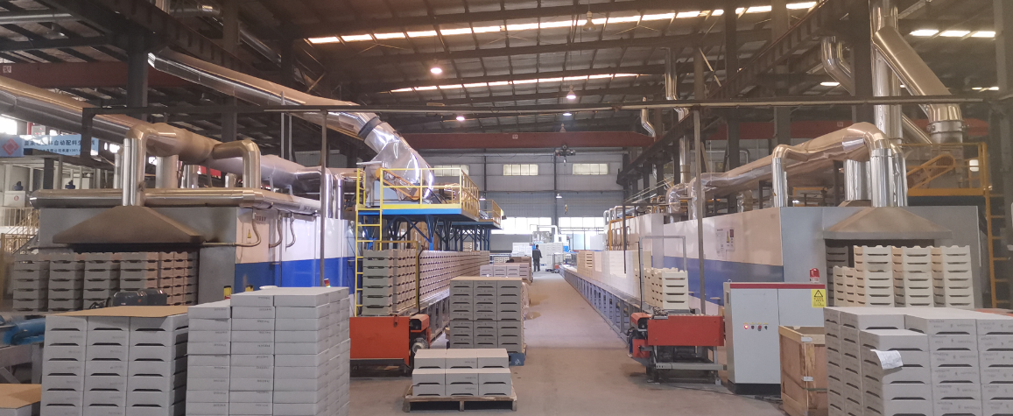
▶ Corundum Sagger
◎（Application Fields）： （High-nickel ternary cathode materials (NCM/NCA), lithium cobalt oxide (LCO), electronic ceramics, rare earth calcination, high-purity powder materials, magnetic materials）
●（Operating Temperature）： 1200℃-1700℃
● （Product Features）： （ 1.Excellent high-temperature alkali corrosion resistance, highly resistant to powdering and surface peeling, with extended service life under high-activity cathode material conditions）
（2.Outstanding high-temperature flexural strength and thermal shock resistance, no cracking during long-term continuous kiln operation）
（3.Dense and smooth surface, free of impurities and dust, with low material adhesion and easy cleaning）
( 4.Extremely low magnetic impurity content and trace element precipitation, fully ensuring the purity of battery cathode materials)
Fully automatic pusher kiln

Slide 4
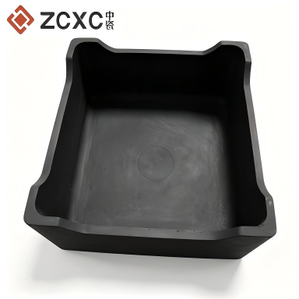
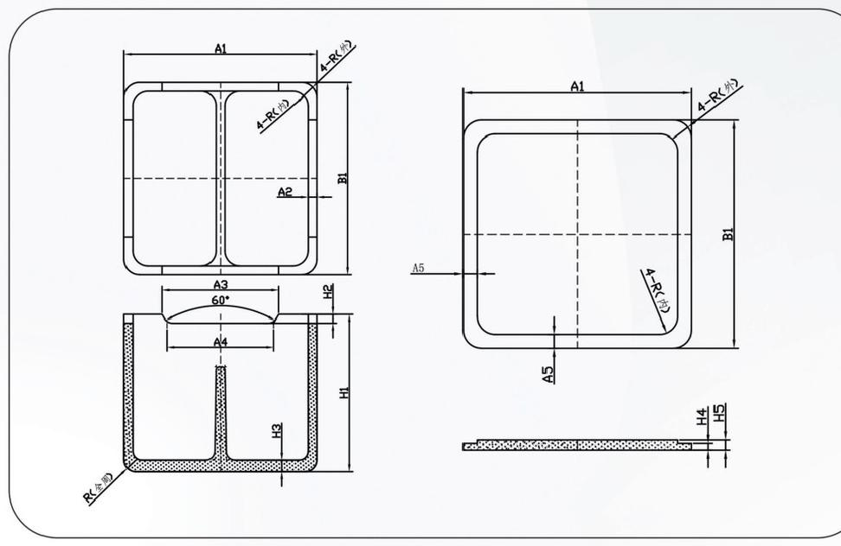
▶ Graphite Sagger
◎（Application Fields）： （High-nickel ternary cathode materials (NCM/NCA), lithium cobalt oxide (LCO), electronic ceramics, rare earth calcination, high-purity powder materials, magnetic materials）
●（Operating Temperature）： 1000℃-3000℃
● （Product Features）： High purity, high density, high mechanical strength, excellent chemical stability with low impurity precipitation
Oxidation & corrosion resistant under inert atmosphere, service life over 24 months, low consumable cost
Outstanding thermal shock resistance, excellent electrical and thermal conductivity for uniform temperature field
● Technical Parameters of Graphite Sagger
Index \ Material | Bulk Density (g/cm³) | Resistivity (μΩ·m) | Compressive Strength (MPa) | Flexural Strength (MPa) | Coefficient of Thermal Expansion (×10⁻⁶/℃) | Thermal Conductivity (kcal/(m·h·℃)) | Ash Content (%) | Carbon Content (%)
High-purity Molded Graphite | ≥1.78 | ≤8 | ≥75 | ≥30 | 4.5 | >185 | ＜0.1 | 99.8

Slide 5
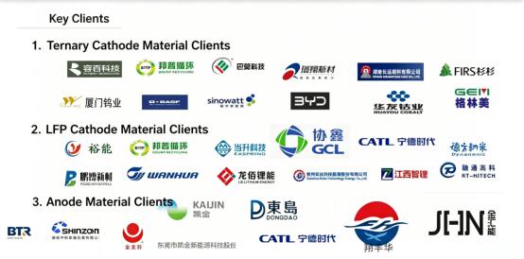
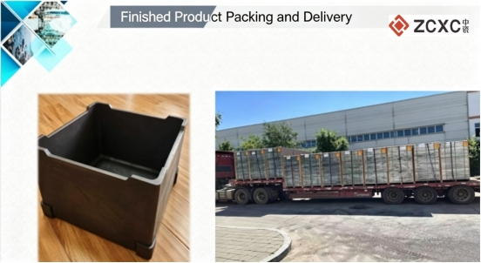
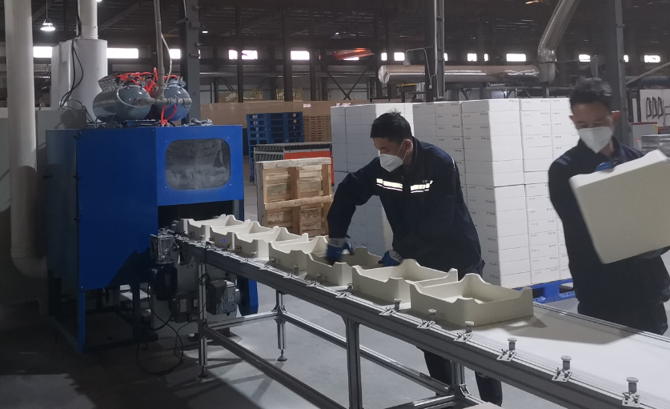
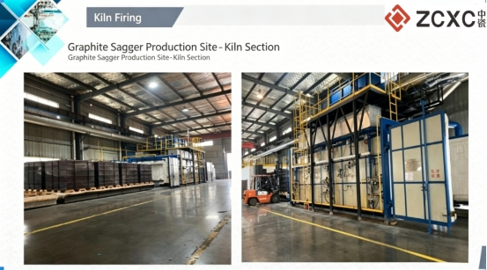
Sagger Sorting

